Slide 1

Gradient Descent
Linear regression with one variable
Machine Learning
Slides from CS-229 by Andrew Ng

Slide 2
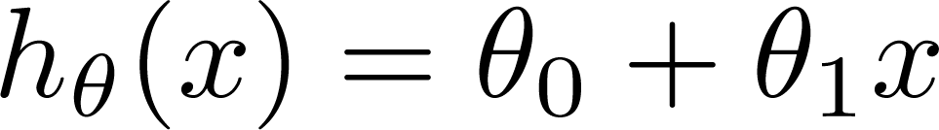
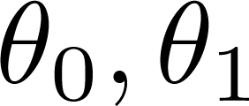
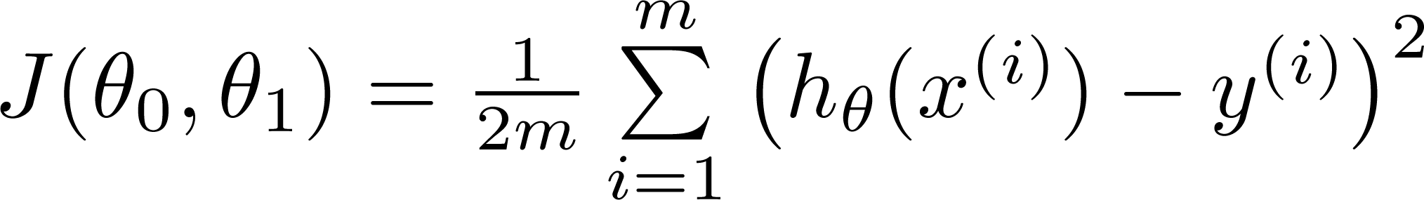
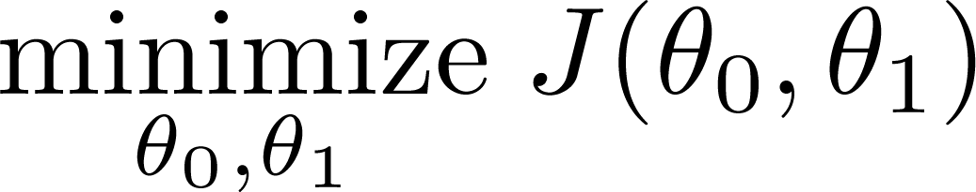
Recap
Hypothesis:
Parameters:
Cost Function:
Goal:

Slide 3






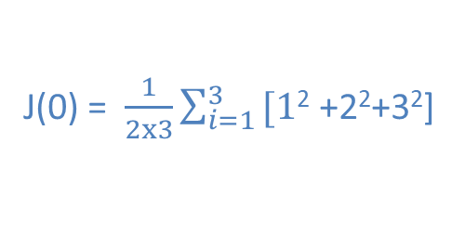

Recap
(for fixed , this is a function of x)
(function of the parameter )
y
x
J($\text{0}$) = $\frac{1}{2x3}\sum_{i=1}^{3}{\text{[1}\text{2} \text{+2}\text{2}\text{+}\text{3}\text{2}\text{]} }$
= $\frac{1}{6}∙14$ = 2.3

Slide 4
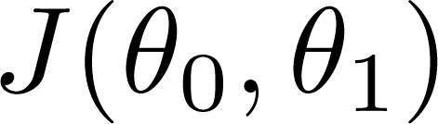
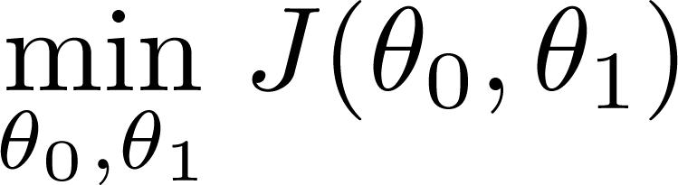
Idea
Have some function
Want
Outline:
Start with some
Keep changing to reduce until we hopefully end up at a minimum

Slide 5
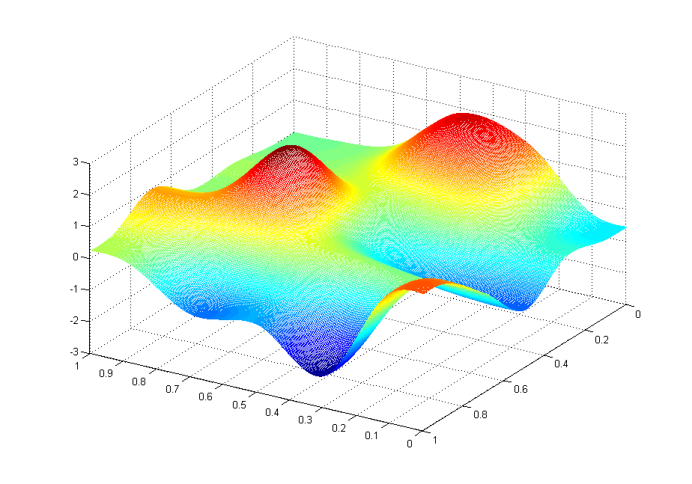
Intuitively
J(θ₀,θ₁)
θ₁
θ₀

Slide 6
Intuitively
J(θ₀,θ₁)
θ₁
θ₀

Slide 7
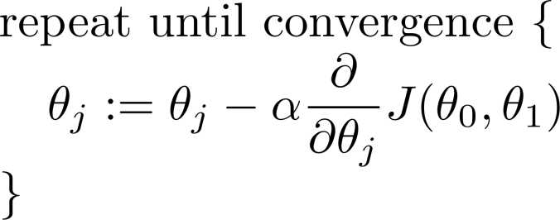
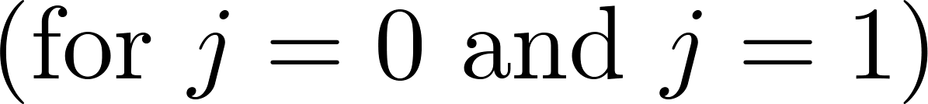
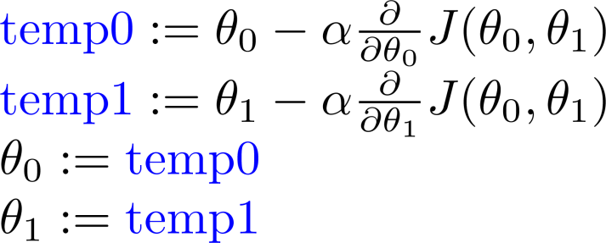
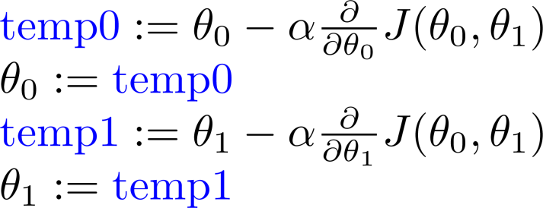
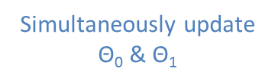
Gradient descent algorithm
assignment
a:=b
Simultaneously update $\text{Θ}\text{0}$&$\text{Θ}\text{1}$
Learning rate
Correct: Simultaneous update
Incorrect:

Slide 8
Gradient descent intuition
Linear regression with one variable
Machine Learning

Slide 9
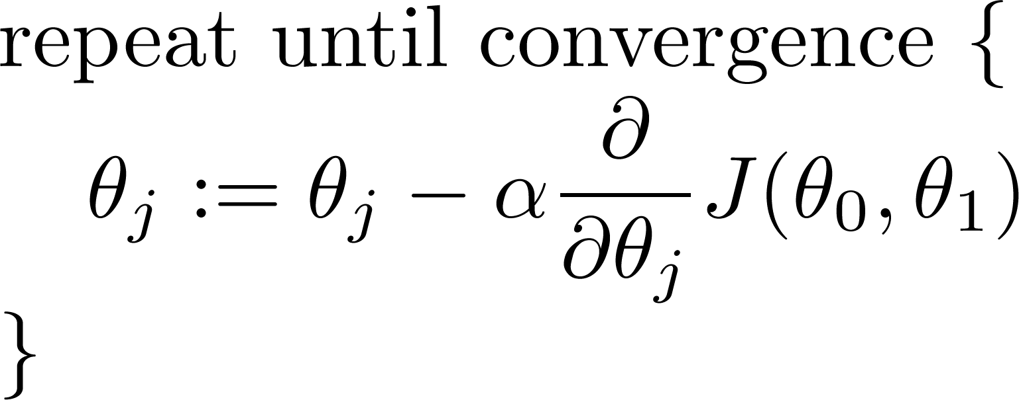
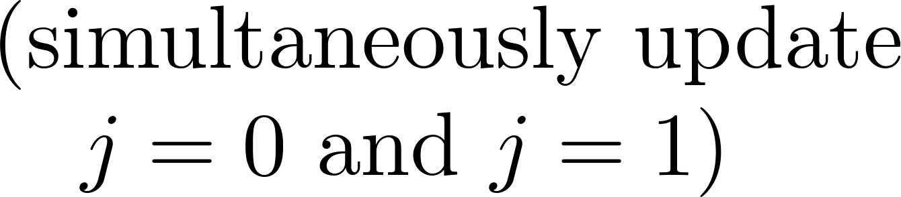
Gradient descent algorithm
Learning rate
derivative

Slide 10
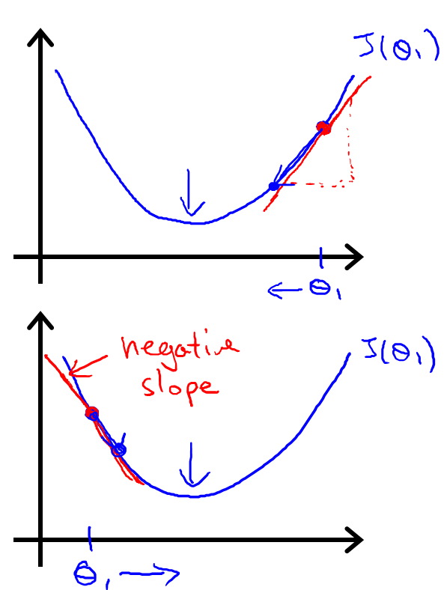






$\text{Θ}\text{1}$ := $\text{Θ}\text{1}$ - $α\frac{d}{dθ_{1}}J(θ_{1})$
$$≥0$$
$\text{Θ}\text{1}$ := $\text{Θ}\text{1}$ - $α∙J(positive number)$
$\text{Θ}\text{1}$ := $\text{Θ}\text{1}$ - $α\frac{d}{dθ_{1}}J(θ_{1})$
$$≤0$$
$\text{Θ}\text{1}$ := $\text{Θ}\text{1}$ - $α∙J(negative number)$

Slide 11
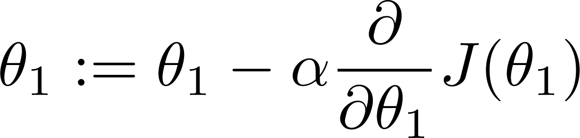
If α is too small, gradient descent can be slow.
If α is too large, gradient descent can overshoot the minimum. It may fail to converge, or even diverge.

Slide 12
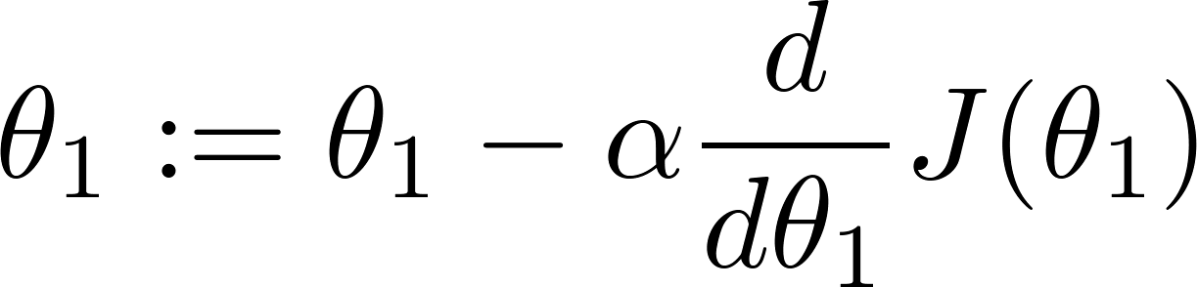
Gradient descent can converge to a local minimum, even with the learning rate α fixed.
As we approach a local minimum, gradient descent will automatically take smaller steps. So, no need to decrease α over time.

Slide 13
Gradient descent for linear regression
Linear regression with one variable
Machine Learning

Slide 14
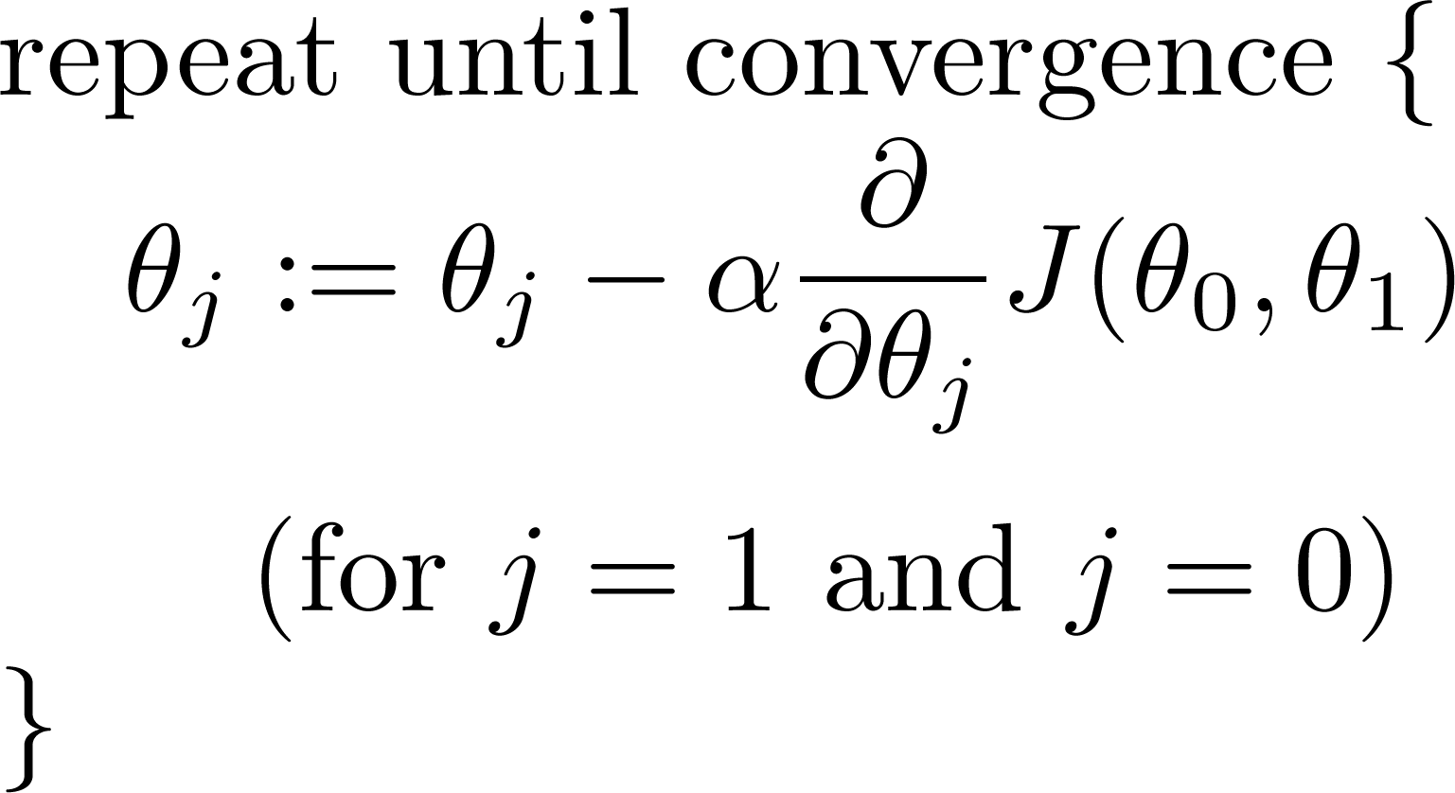
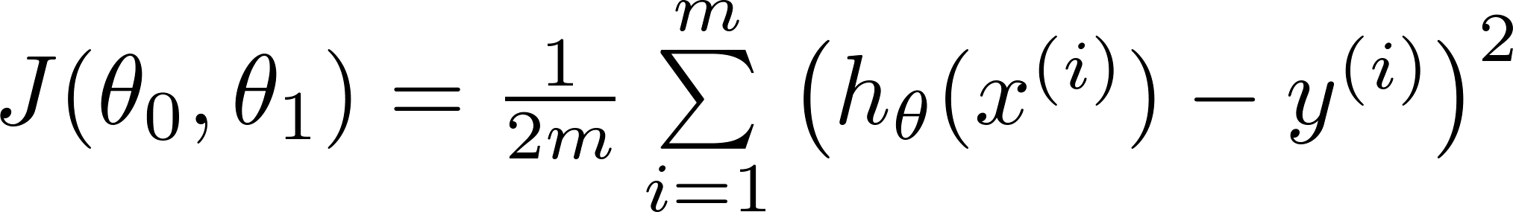
Gradient descent algorithm
Linear Regression Model

Slide 15
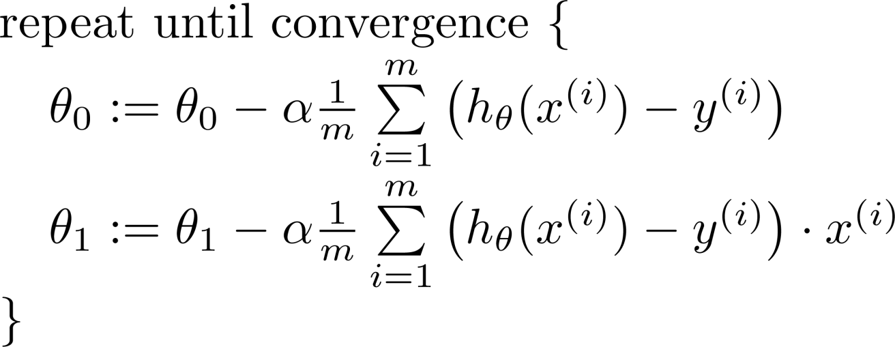



Gradient descent algorithm (Linear Regression)
$\frac{d}{dθ_{0}}∙J(θ_{0},θ_{1})$
update
and
simultaneously
$\frac{d}{dθ_{1}}∙J(θ_{0},θ_{1})$

Slide 16
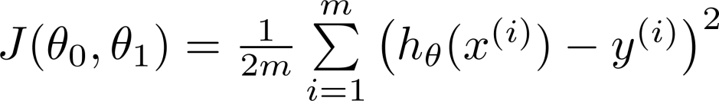
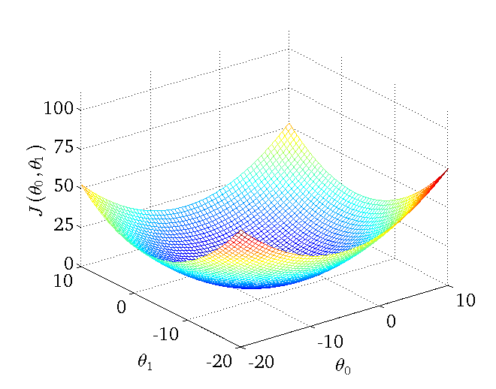
Hypothesis:
Cost Function:
Convex function
(Bowl-shaped)

Slide 17


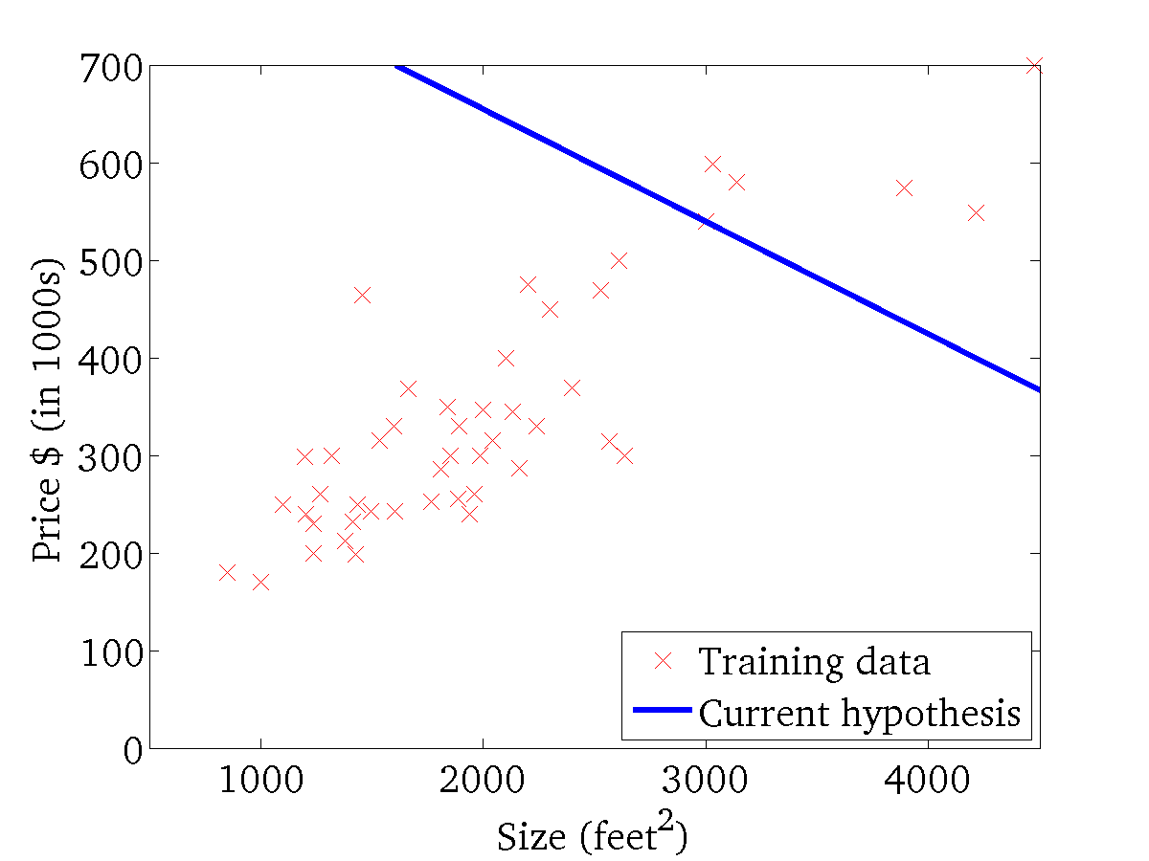
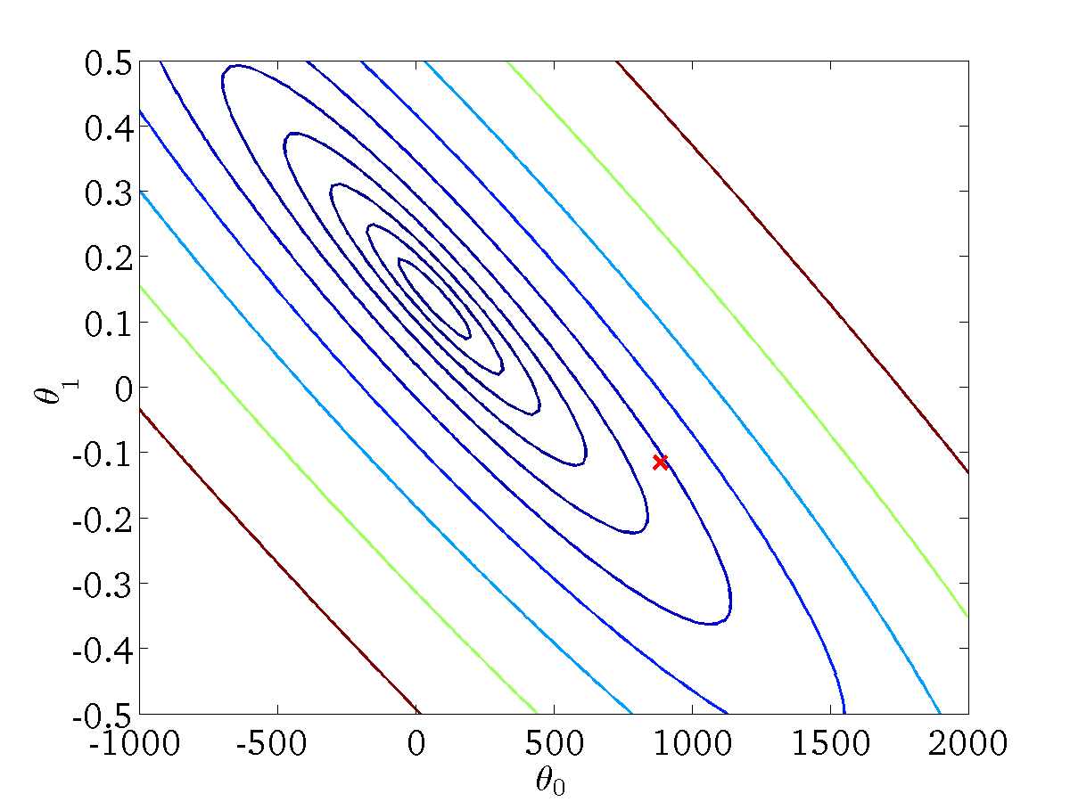
(for fixed , this is a function of x)
(function of the parameters )

Slide 18
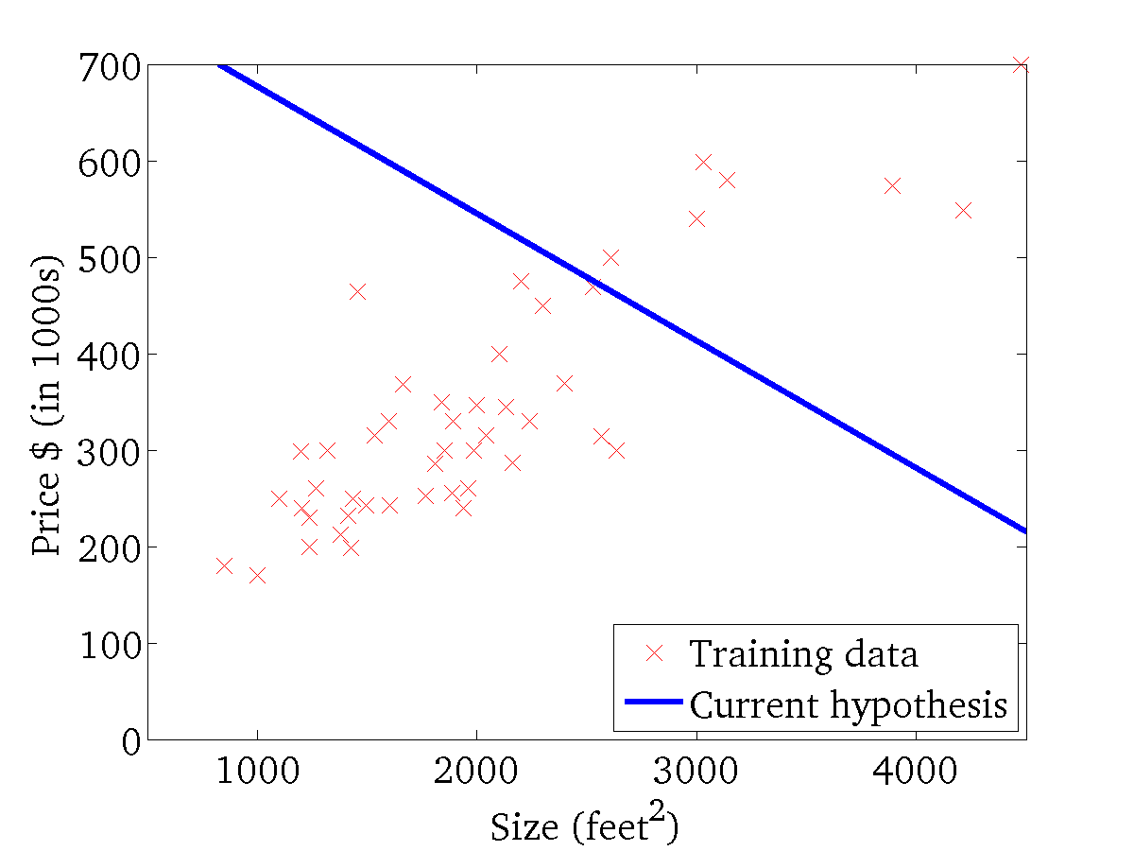

(for fixed , this is a function of x)
(function of the parameters )

Slide 19
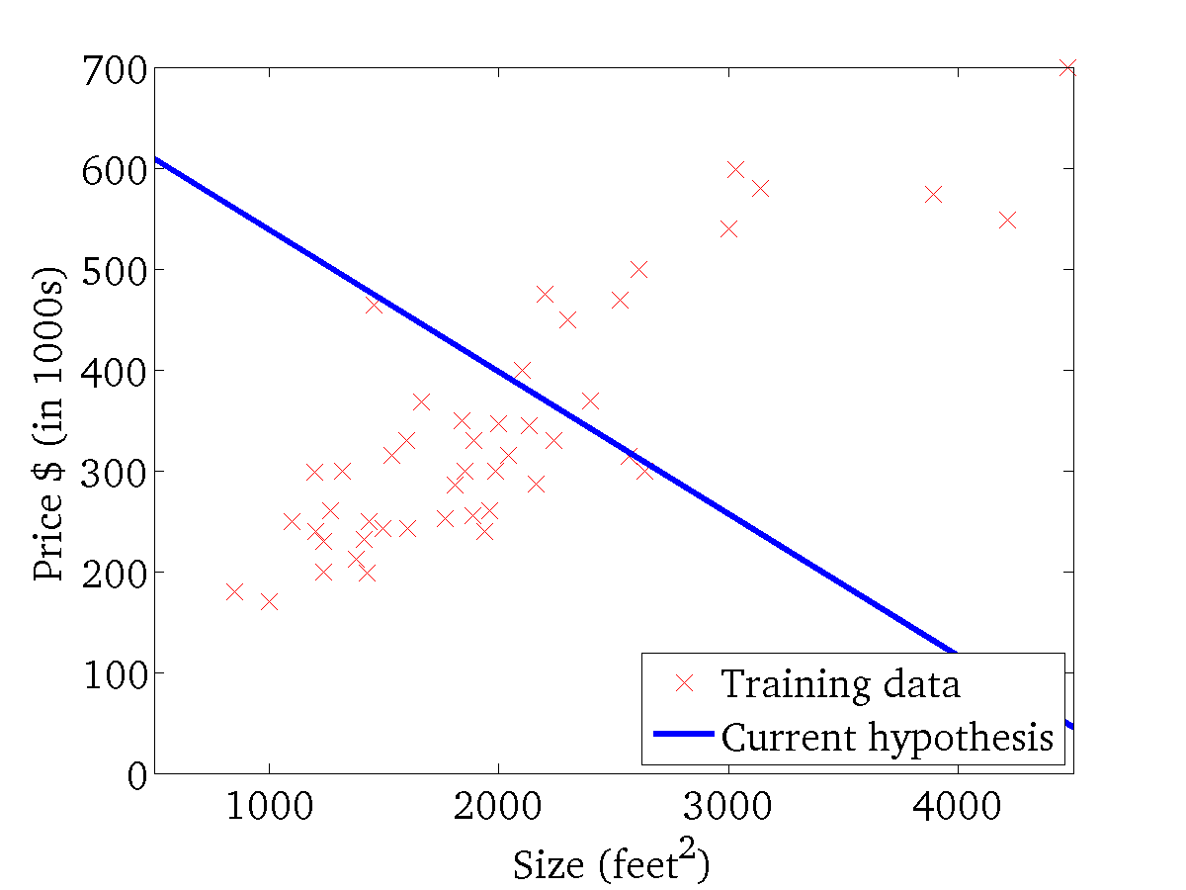
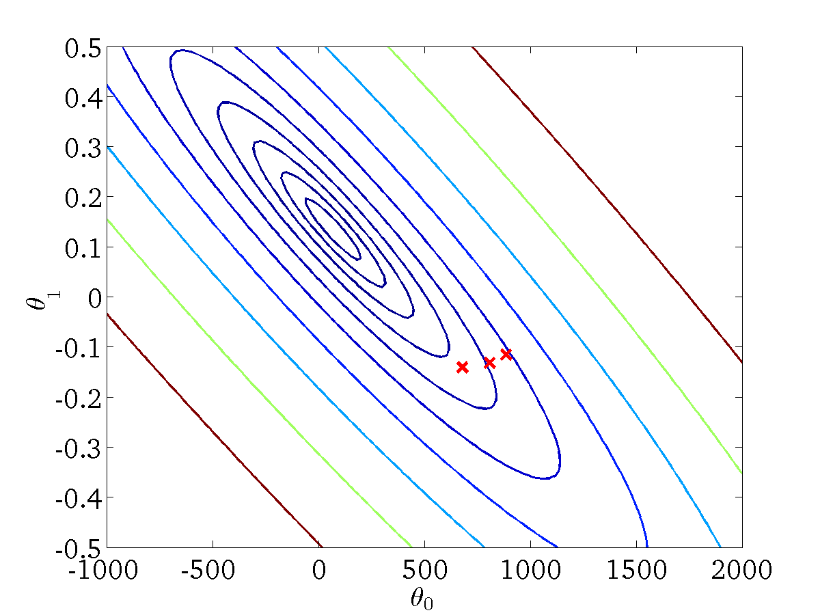
(for fixed , this is a function of x)
(function of the parameters )

Slide 20
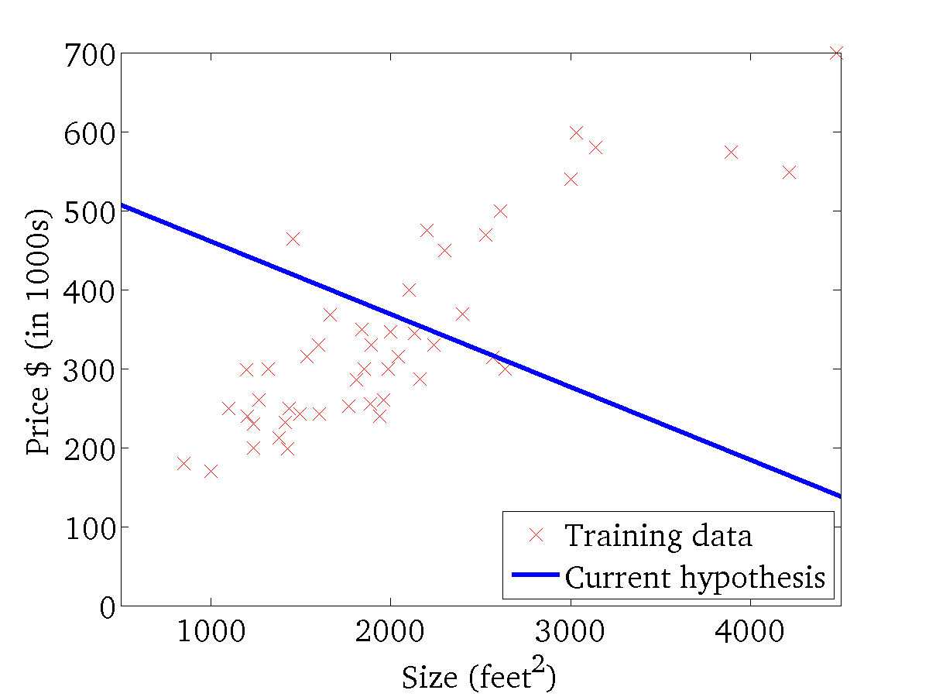

(for fixed , this is a function of x)
(function of the parameters )

Slide 21
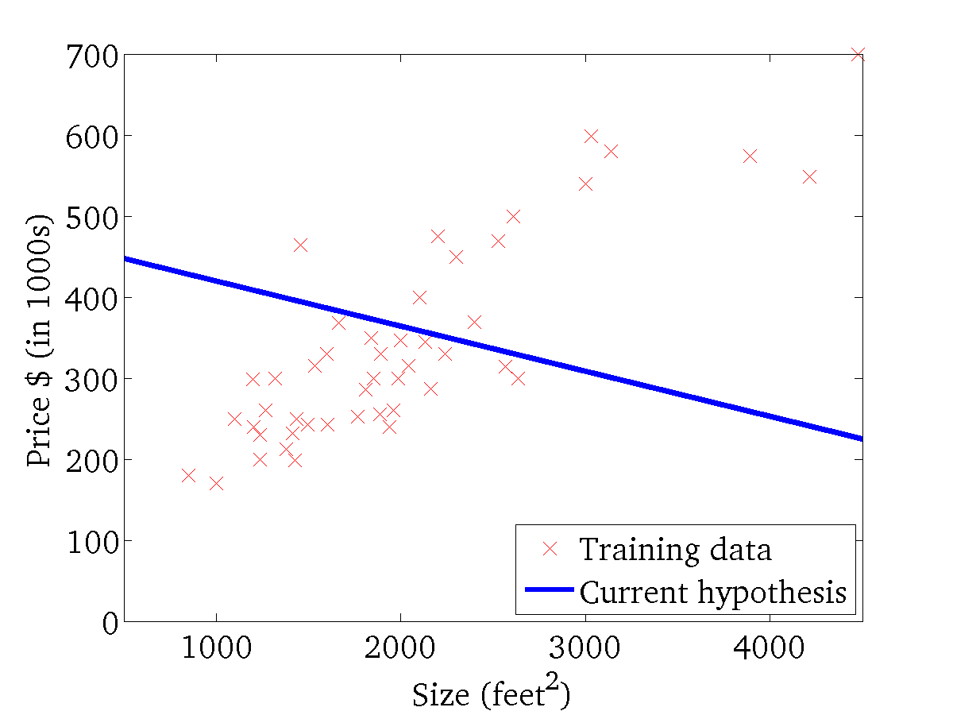
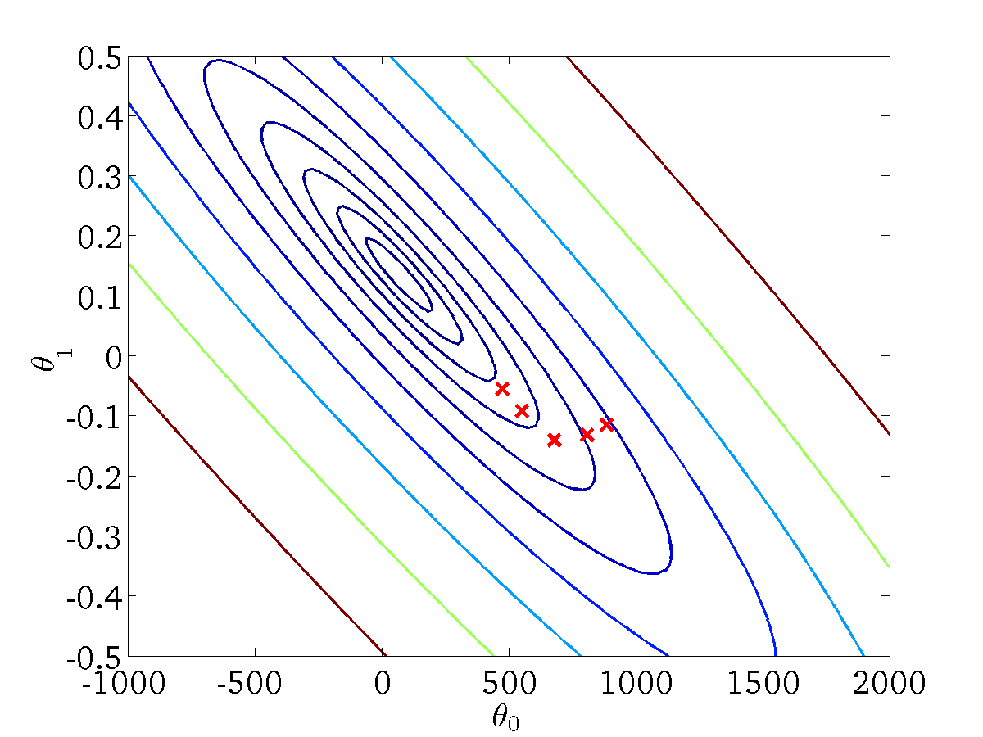
(for fixed , this is a function of x)
(function of the parameters )

Slide 22
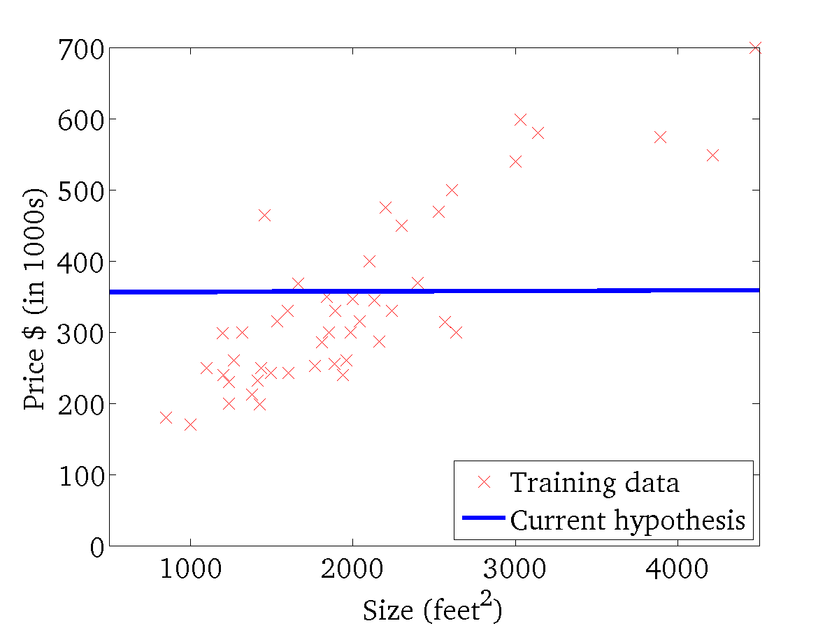

(for fixed , this is a function of x)
(function of the parameters )

Slide 23
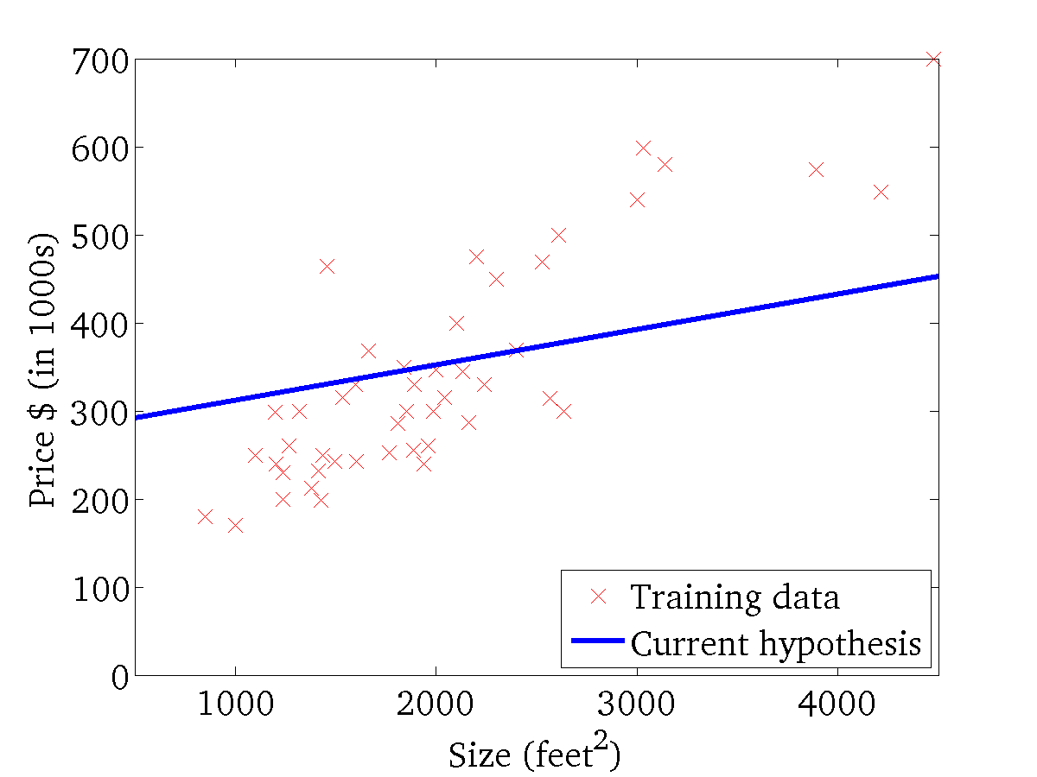

(for fixed , this is a function of x)
(function of the parameters )

Slide 24
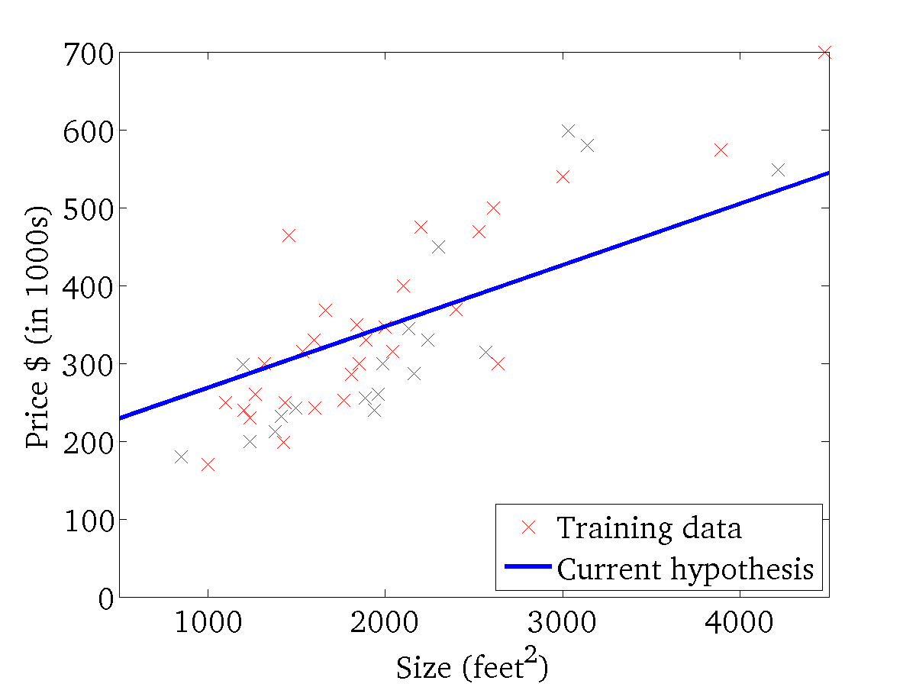
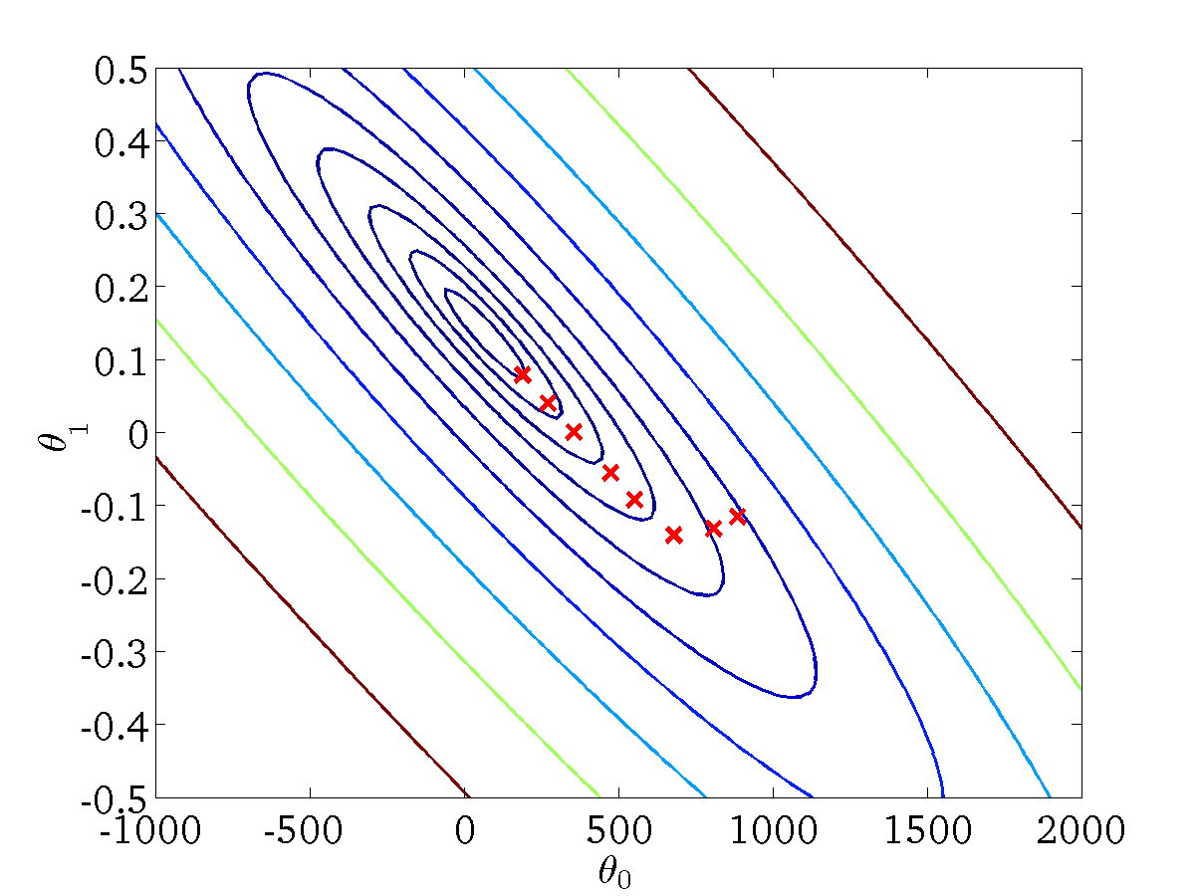
(for fixed , this is a function of x)
(function of the parameters )

Slide 25
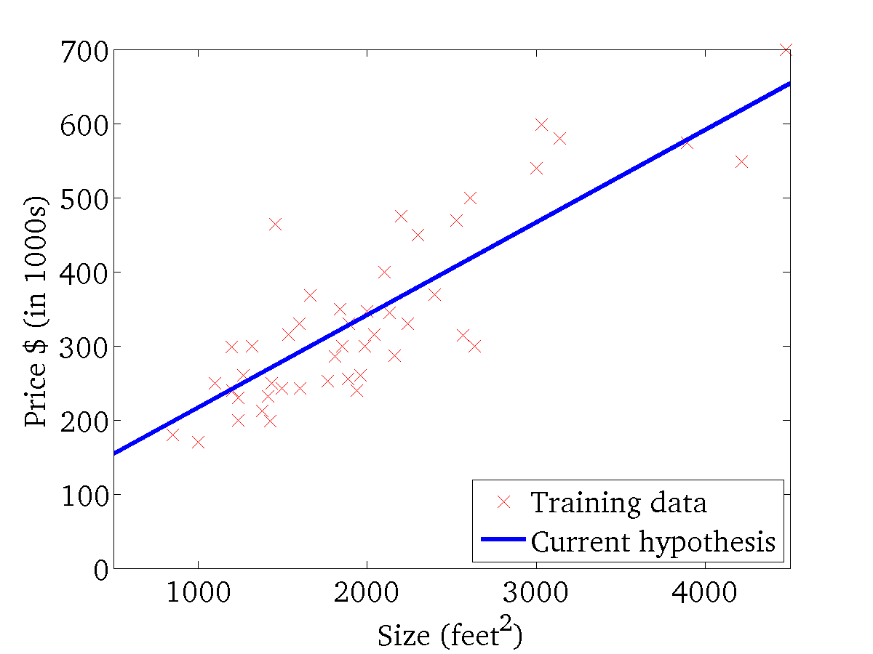

(for fixed , this is a function of x)
(function of the parameters )

Slide 26
(Batch) Gradient Descent algorithm
$\frac{d}{dθ_{0}}∙J(θ_{0},θ_{1})$
update
and
simultaneously
$\frac{d}{dθ_{1}}∙J(θ_{0},θ_{1})$

Slide 27
“Batch” Gradient Descent (BGD)
“Batch”: Each step of gradient descent uses all the ‘m’ training examples.

Slide 28




repeat until convergence {
for i = 1 to m {
}
}
(Stochastic) Gradient Descent algorithm
$\frac{d}{dθ_{0}}∙J(θ_{0},θ_{1})$
$$θ_{0} := θ_{0}− α \left(h_{θ}\left(x^{\left(i\right)}\right)− y^{\left(i\right)}\right)$$
update
and
simultaneously
$$θ_{1} := θ_{1}− α \left(h_{θ}\left(x^{\left(i\right)}\right)− y^{\left(i\right)}\right). x^{\left(i\right)}$$
$\frac{d}{dθ_{1}}∙J(θ_{0},θ_{1})$

Slide 29
“Stochastic” Gradient Descent (SGD)
“Stochastic”: Each step of gradient descent uses one training example or a mini-batch of data (especially in deep learning).

Slide 30
Batch Vs. Stochastic Gradient Descent

Slide 31
Batch Vs. Stochastic Gradient Descent
BGD computationally expensive on large datasets
SGD has a possibility of escaping from local/global minimum
SGD often gets close to the minimum much faster than BGD
SGD typically used in practice on large datasets

